Slide 1

Supplementary Live Session Week 4
MET CS 682
Information Systems
Analysis and Design
Professor Williams
Last Updated 2/3/2024

Slide 2
Agenda
Purpose of Modeling
Object Oriented Concepts Review
UML Models
Picking Classes
Sequence Diagrams
Class Model - components,
Class Model (Start to discuss Relationships)
Sequence Diagrams
Class Model (components, relationships)
Developing a Class Model

Slide 3
Where are we? Main Phases of Software Process
Initiation/Planning
Identifying problem & opportunity, outlining project
Requirements Analysis
Specification of application
Design
Specification, Design of parts
Implementation
Coding, Installation, Integration
Testing
Does it do what it’s supposed to
Maintenance
Defect repair, minor modifications/extensions

Slide 4
Importance of Design and Modeling
“We build models of complex systems because we cannot comprehend such a system in its entirety”
(Booch, G., Rumbaugh, J., Jacobson I. 2005).
Visualize desired structure and behavior of the system
Decompose technical details into comprehendible parts
Gain deeper understanding of the technical details which may be hard to grasp
Communicate desired structure and behavior of the system to system builders
Strive to realize Design goals such as:
Sufficiency (build what was requested)
Reusability (in another project)
Flexibility (make modifications easily after the initial build)
Provide a Guide of the desired structure and behavior to system builders during implementation

Slide 5
Principles of Modeling
Choose what to model – focus on complex parts and decide which model will help visualize the design most effectively.
Decide who to model for – who will read it and how they will use it.
Consider different levels of detail – various models will complement each other and show how the system fits together from various points of view.
Apply standards - models need to be consistent, comprehendible and maintainable.

Slide 6
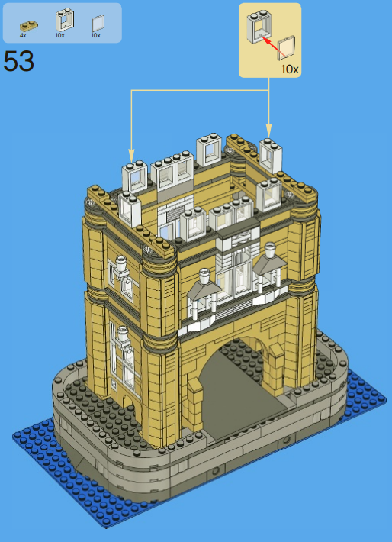
Types of Models - Structural
Structural Models -visualize and specify the structure of the system, it’s parts, and how it is to be assembled.
https://www.lego.com/en-us/themes/creatorexpert/products/tower-bridge-10214

Slide 7
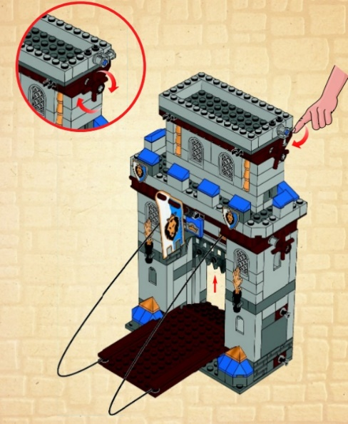
Types of Models - Behavior
Behavior Models – visualize operational components of the system, how components will operate once constructed.
https://shop.lego.com/en-US/King-s-Castle-70404

Slide 8
Unified Modeling Language (UML)
The Unified Modeling Language (UML) is a set of modeling conventions that is used to specify or describe a software system in terms of objects. (Whitten, 2007)
Graphical notation for expressing object-oriented analysis and design.
Modern tool bag for systems analysis.
Easy to understand not only by system developers, but by customers as well.
“Is this what you want to be developed?”
Some parts of UML are accessible to the layman, others not.
Can be used to show varying degrees of complexity
verify and document application requirements
support a visual representation of an application design.
The level of detail and complexity should be appropriate to the anticipated audience.
(CS682 Module 3)

Slide 9
UML 2.5 Diagrams
Diagram | Description | Module Introduced
Use Case Model/Narrative (Behavior Model) | Depicts interactions between the system and external systems and users. Graphically depicts users who will use the system and in what ways the user expects to interact with the system. The use-case narrative is used in addition to a textual description of the sequence of steps of each interaction. | Module 1 and Module 3
Activity (Behavior Model) | Depicts sequential flow of activities in a use case or business process at high level, or model logic within the system at a very detailed level. | Module 1 and Module 6
State Transition and State Machine (Behavior Model) | Models how events can change the state of an object (or a system) over its lifetime, showing both the various states that an object (or system) can assume and the transitions between those states. | Module 3
Sequence (Behavior Model) | Graphically depicts how objects interact with each other via messages in the execution of a use case or operation. It illustrates how messages are sent and received between objects and in what sequence. | Module 4
Class (Structural Model) | Depicts the system's class structure. It shows the classes that the system is composed of as well as the relationships between those classes. | Module 4

Slide 10
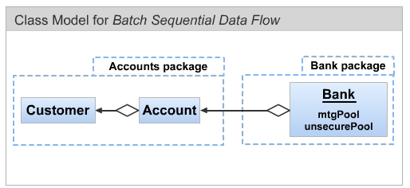
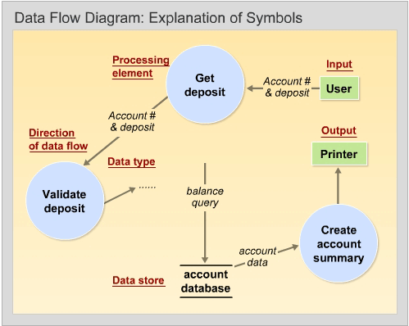
UML 2.5 Diagrams
Diagram | Description | Module Introduced
Package (Structural Model) | Depicts how classes or other UML constructs are organized into packages (corresponding to Java packages) and the dependencies of those packages. | Module 5
Data Flow (Behavior & Structural Model) | Depicts the flow of data through a system and the work or processing performed by the system. | Module 5
Network Architecture (Structural Model) | A type of physical data flow diagram that allocates processors and devices to a network showing their connectivity. | Module 5
Figure 10-9 Page 382 Whitten, B. (2007).

Slide 11
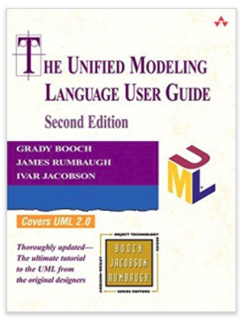
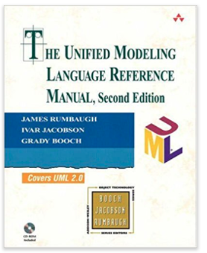
UML Text
The Unified Modeling Language User Guide (2nd Edition)
ISBN-13: 978-0321267979
Booch G, Rumbaugh, J, Jacobson I
The Unified Modeling Language Reference Manual (2nd Edition)
ISBN-13: 978-0321245625
Rumbaugh J,‎ Jacobson I‎, Booch G

Slide 12
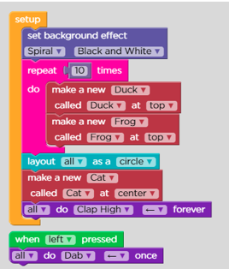
Software Modeling
Algorithmic modeling -traditional approach a procedure or a function is the focus
(i.e. BASIC, Pascal, COBOL, Fortran)
Object-oriented modeling- envision everything as a set of objects and these objects put together will function as a software system.
What’s the advantage?
Represents real world
Focus on reusability, modification
Source: Code.org

Slide 13
Object Oriented (OO) Analysis, Modeling & Design
Object-oriented analysis (OOA) – an approach used to
study existing objects to see if they can be reused or adapted for new uses
define new or modified objects that will be combined with existing objects into a useful business computing application (Whitten, 2007)
Object modeling – a technique for identifying objects within the systems environment and the relationships between those objects. (Whitten, 2007)
Object-oriented design (OOD) – an approach used to specify the software solution in terms of collaborating objects, their attributes, and their methods. (Whitten, 2007)
Unified Modeling Language (UML) – a set of modeling conventions that is used to specify or describe a software system in terms of objects. (Whitten, 2007)

Slide 14


Entities & Objects
Entity: A class of persons, places, objects, events or concepts about which we need to capture and store data. (Whitten, 2007)
Person, house, vehicle, book (concrete physical entities)
Bank account (abstract entity)
Entity Object
Instance
Object: Something specific that is or is capable of being seen, touched, or otherwise sensed, and about which users store data and associate behavior. (Whitten, 2007)
Bob Smith, The White House, Toyota Corolla, “Information Systems Analysis and Design”, Bank account “17346”
Object is a unique and identifiable instance of entity (class). Dennis, A., Wixom, B. H., & Tegarden, D. (2015).

Slide 15
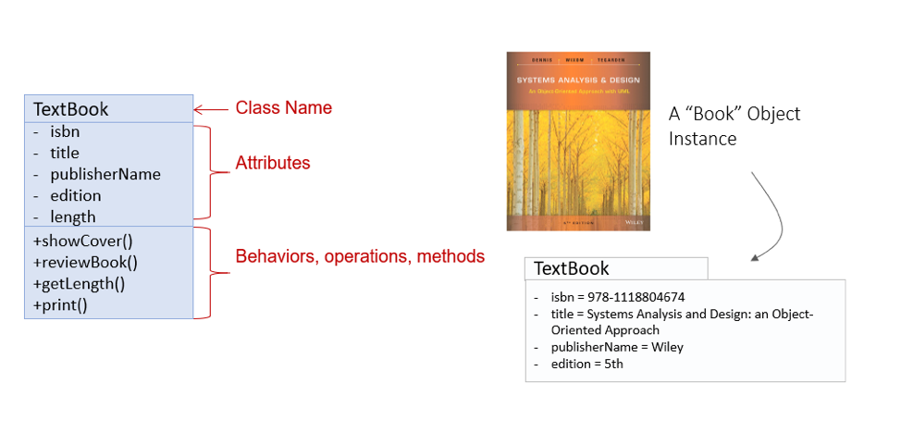
Entity Class
An Entity Class is a set of object instances that share common attributes and behavior (methods).
Example: “Systems Analysis and Design” Object is an Instance of an Entity class “TextBook”

Slide 16
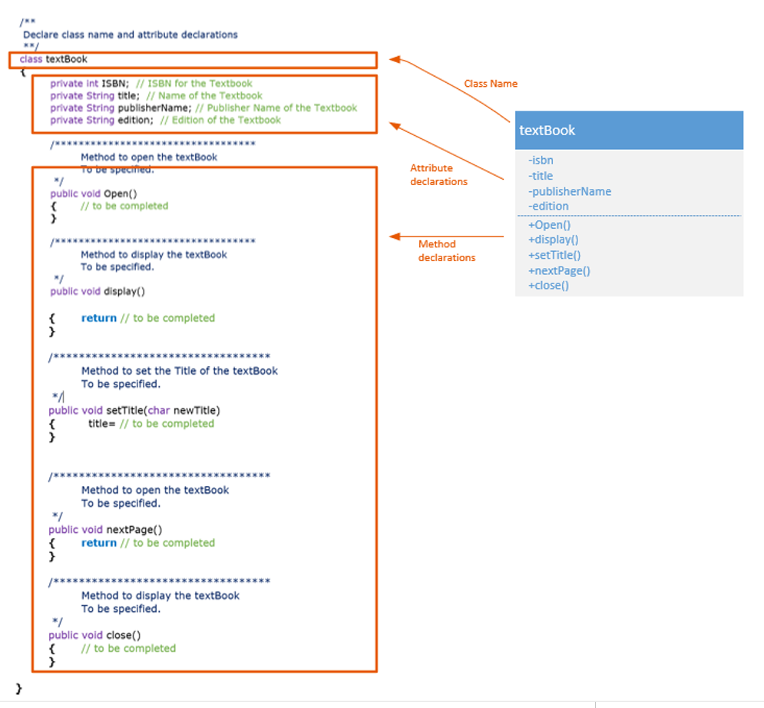

Slide 17
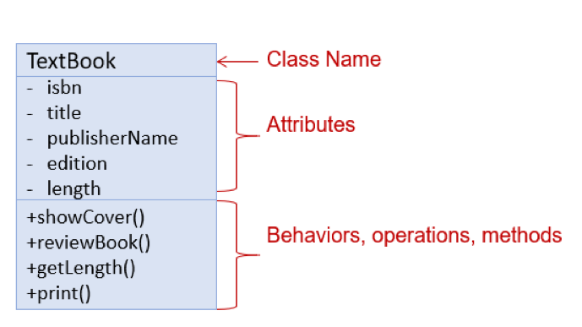
Visibility & Encapsulation Between Classes
Visibility Category | Symbol | What Methods can Access Members of this Category
Private | - | Only visible to methods in the class
Protected | # | Only visible to methods in the class and subclasses.
Package scope | ~ | Only visible to methods in classes in the package
Public | + | Visible to any method that knows the name of the member

Slide 18
Types of Classes
Types of classes to focus on in CS682
Entity/Business Class - contains business related information and implements analysis classes. Entity classes should be your main focus.
Design Class - provides the means by which an actor interacts with the system.
A window, dialog box, or screen.
Interface Classes – handles communication with other systems (these are sometimes called application program interfaces API)
Control Class - contains application logic.
Types of classes out of scope for CS682 – please avoid these in your solutions
Persistence Class - provides functionality to read and write to a database.
System Class - handles operating system-specific functionality.
(Whitten, 2007)

Slide 19
Ok… But Where do We start?
Document system analysis Use-Case narratives.
Find and identify the business objects, attributes and methods (Class).
Nouns: Objects, Attributes (i.e. Person)
Verbs: Methods (i.e. Sleep(), Eat())
Go back and forth iteratively between Use-Case and Sequence Diagram, consider what’s missing and keep refining the diagram.
Consider Listing the steps of the Use Case within the sequence diagram.

Slide 20
Finding & Identifying Business Objects
Find the Potential Objects
Review each use case to find nouns that correspond to business entities or events.
Select the Proposed Objects
Not all nouns represent business objects.
Is it a synonym of another object?
Is it outside the scope of the system?
Is it a role without unique behavior, or an external role?
Is it unclear or in need of focus?
Is it an action or an attribute that describes another object?
(Whitten pages 396-406, 2007)

Slide 21
Use Case for Finding a Book
Use-Case Name | Find Book and its location
Actor: | Librarian
Description: | This use case describes the event of a Librarian searching for a book based on key words, selecting a specific book and finding its location.
Precondition: | System displaying search screen
Step # | Actor | System
1 | Librarian enters key words for the book and clicks on Search button | System performs a search for potential matches.
2 |  | System displays a list of potential matches ranked by most relevant results.
3 | Librarian selects a specific book by clicking on its name (a link) | System displays selected book information
4 | Librarian clicks on a link for book location | System displays book location
Alternate Courses: | Alt Step #2 (System) System displays no matching results. Alt Step #3 (Actor)– Actor clicks on back button to start new search.
Implementation Constraints: | System shall not take more than one second to find and display results.

Slide 22
Determining Classes/Attributes/Methods
Added detail to the use case to provide a bit more technical information for the sequence diagram.
Highlighted potential entity classes in blue, non-entity in green, attributes in orange –methods purple
Use-Case Name | Find Book and its location
Actor: | Librarian
Description: | This use case describes the event of a Librarian searching for a book based on key words, selecting a specific book and finding its location.
Precondition: | System displaying search screen
Step # | Actor | System
1 | Librarian enters key words for the book and clicks on Search button | System performs a search within library catalog for potential matches.
2 |  | System displays a list of potential matches ranked by most relevant results.
3 | Librarian selects a specific book by clicking on its name (a link) | System displays selected book information
4 | Librarian clicks on a link for book location | System determines which bookshelf the book is located on and displays book location
Alternate Courses: | Alt Step #2 (System) System displays no matching results. Alt Step #3 (Actor)– Actor clicks on back button to start new search.
Implementation Constraints: | System shall not take more than one second to find and display results.

Slide 23
Class Diagram
Class Diagram- graphical depiction of a system’s static object structure, showing object classes that the system is composed of as well as the relationships between those object classes. (Whitten, 2007)
Key Note: Not all of the attributes and operations need be specified in the class model.
We show as much detail as needed—no more.
Showing more detail clutters a diagram and can make it harder to understand.
Some required attributes are left to the discretion of the implementers.

Slide 24
Relationships
Inheritance-Generalization-Specialization
One Class is a type of another class: Superclasses & Subclasses
Example: People Superclass, Student & Teacher Subclasses
Association- Aggregation – Composition
One class part of/has another class
Example: Book is part of a Library
Dependencies
One class uses another class
Example: Search depends on (uses) Book

Slide 25
Sequence Diagrams
Sequence Diagram depicts the interaction between an actor and the system for a use case scenario. (Whitten, 2007)
Graphical representations of control flow and are particularly useful for describing executions that involve objects of several classes participating in the use case.
Where Use cases are limited:
Use Cases need to be developed into more technical forms.
Detailed sequences of actions that applications need to be designed for, but which are not in use cases.
Sequence diagrams require us to think in terms of objects and methods (and messages).

Slide 26
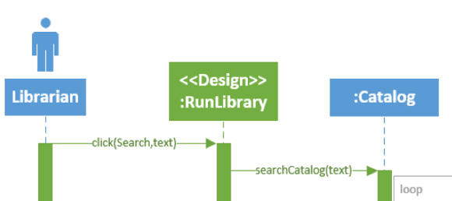
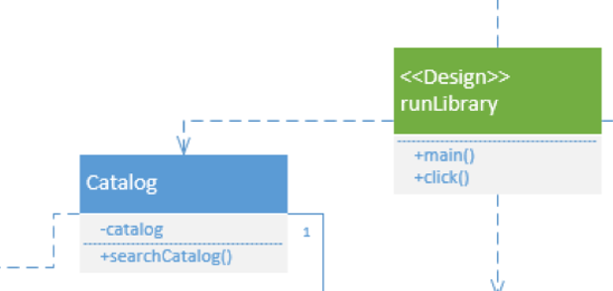
Messages
Message – communication that occurs when one object invokes another object’s method (behavior) to request information or some action (Whitten, 2007)

Slide 27
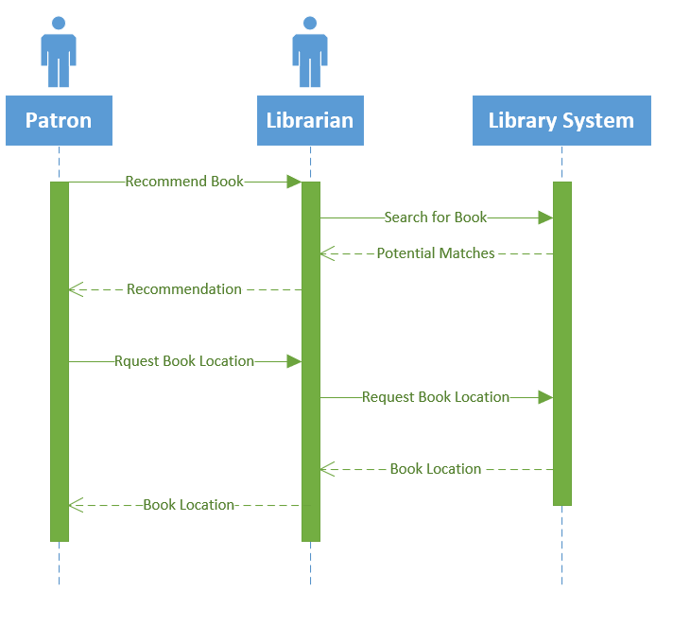
Sequence Diagram
Actor/Object
Object “Instance”
Lifelines
Activation Bars
Input Messages
Output Messages

Slide 28
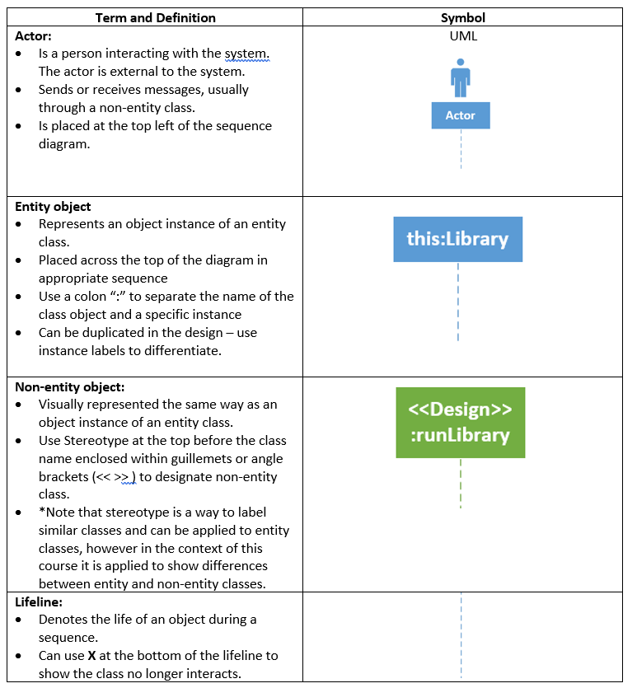
Sequence Diagram Components

Slide 29
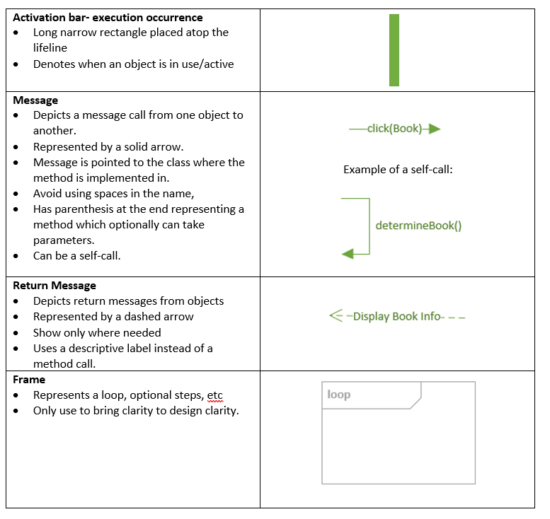
Sequence Diagram Components

Slide 30
Guidelines for Constructing Sequence Diagrams
Identify the scope of the sequence diagram, whether entire use-case scenario or one step.
Draw actor and design class if scope includes that.
List use-case steps down the left-hand side.
Add non-entity classes if scope includes that.
Add entity classes.
Draw messages and point each to class that will fulfill the responsibility.
An object can send a message to itself – this can be indicated by a self-call.
Messages need to cascade down to show a sequence within a timeframe.
Add activation bars to indicate object instance lifetimes.
Add return messages as needed for clarity.
Avoid adding alternate steps – sequence diagrams are not well suited at representing these
Add frames for loops, optional steps, etc if scope includes that.
Verify the sequence diagram consistency by checking against class model and use case.

Slide 31
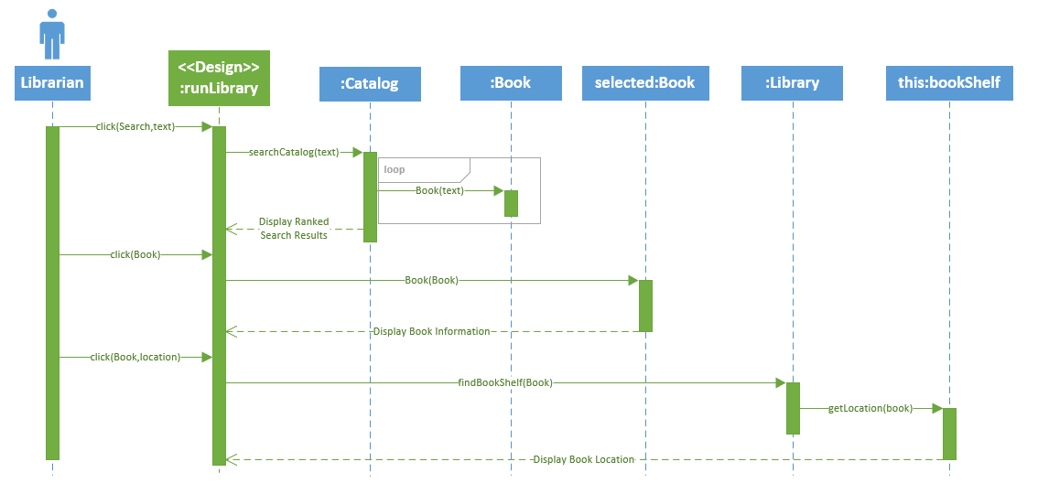
Library Sequence Diagram

Slide 32
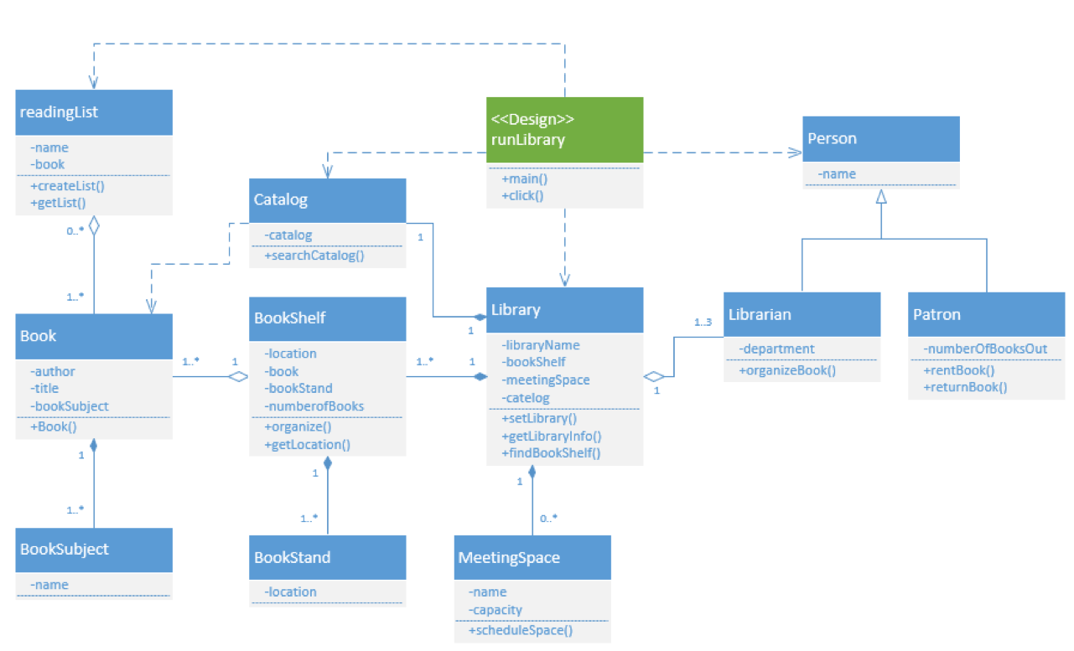
Library Class Model

Slide 33
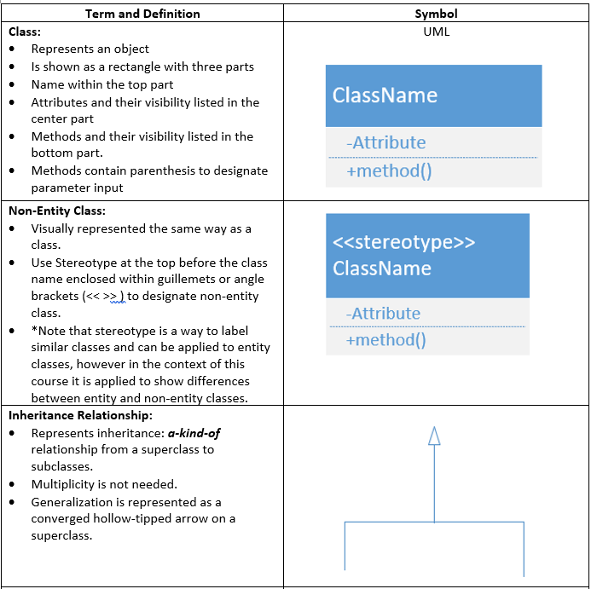
Class Diagram Components

Slide 34
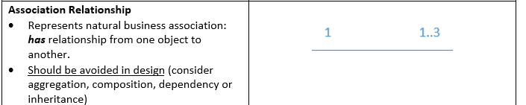
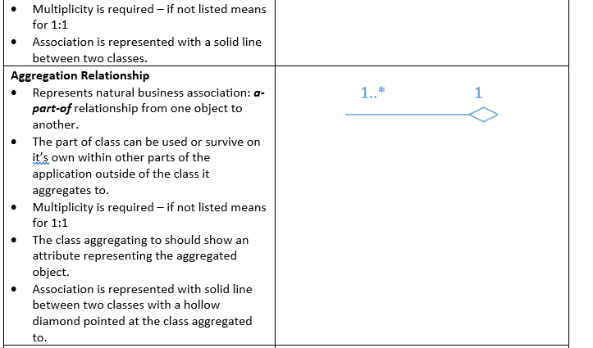
Class Diagram Components

Slide 35
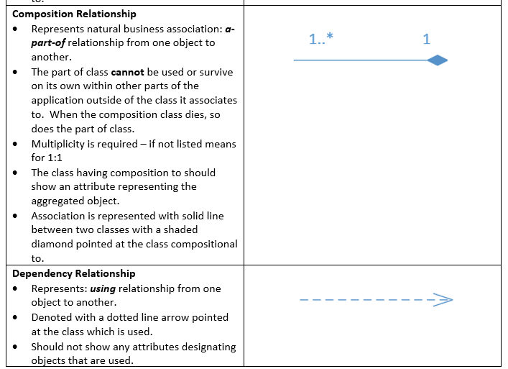
Class Diagram Components

Slide 36
Relationships
Inheritance-Generalization-Specialization
One Class is a type of another class: Superclasses & Subclasses
Example: People Superclass, Student & Teacher Subclasses
Association- Aggregation – Composition
One class part of/has another class
Example: Book is part of a Library
Dependencies
One class uses another class
Example: Search depends on (uses) Book

Slide 37
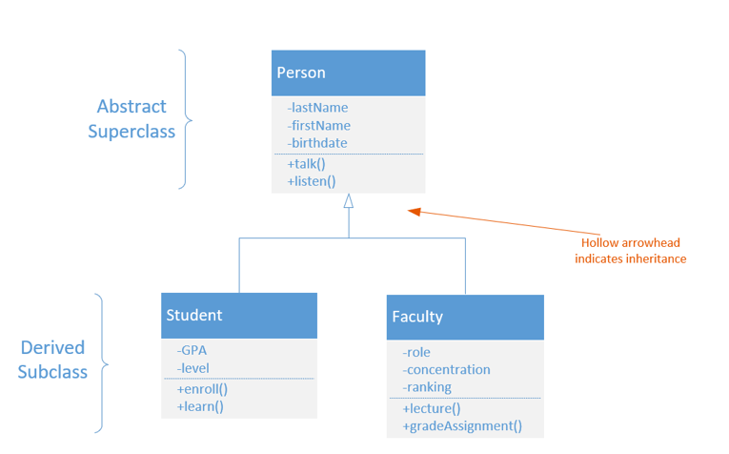
Inheritance: Generalization/Specialization

Slide 38
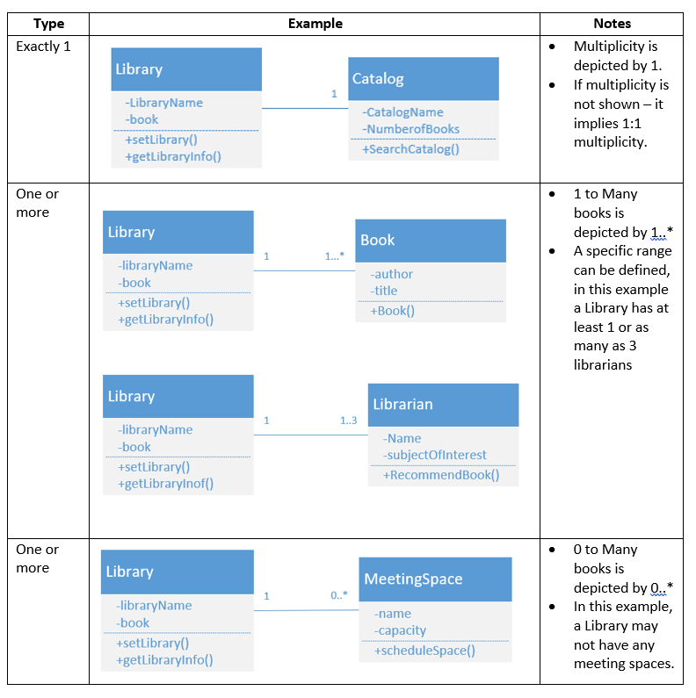
Object Class Relationships
Natural business Association that exists between one or more objects and classes.
Multiplicity – the minimum and maximum number of occurrences of one object/class for a single occurrence of the related object/class.
Figure 10-5 Page 377 Whitten, B. (2007).

Slide 39
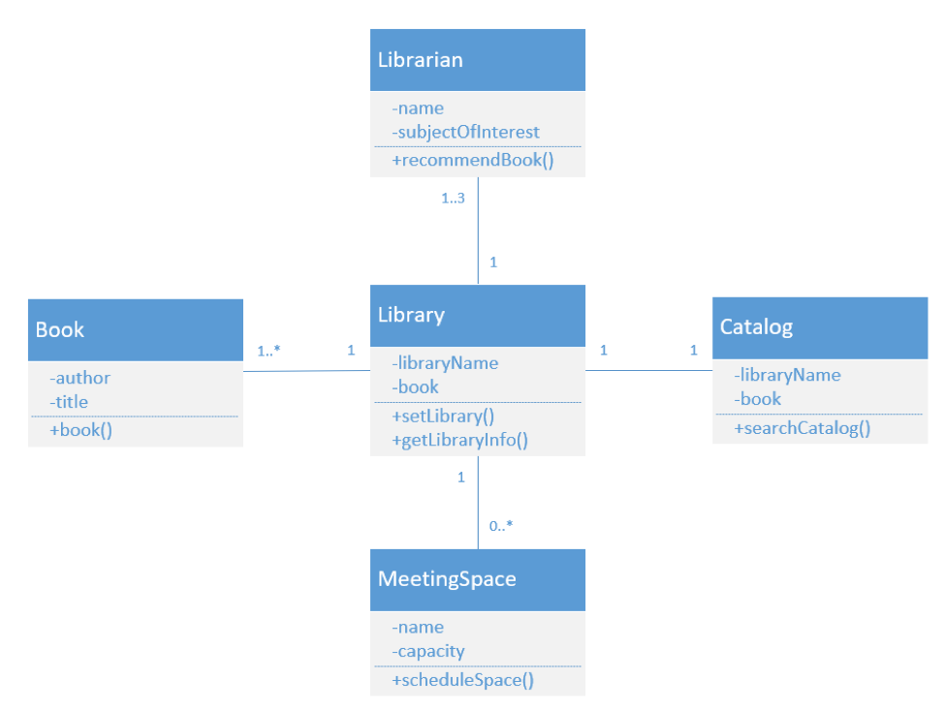
Association
Associations are useful in the early stages of building class model
We know a pair of objects to be related but are postponing the ultimate specification of the relationship such as our Library example above.
However, we should look to replace associations with aggregation, composition or dependency.

Slide 40
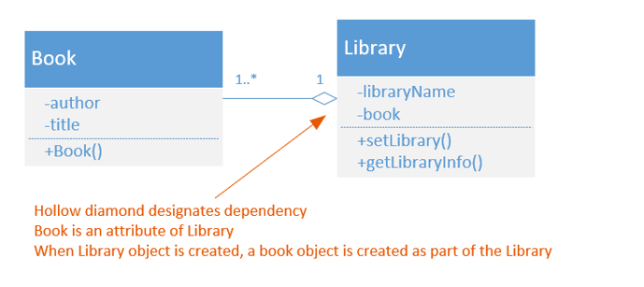
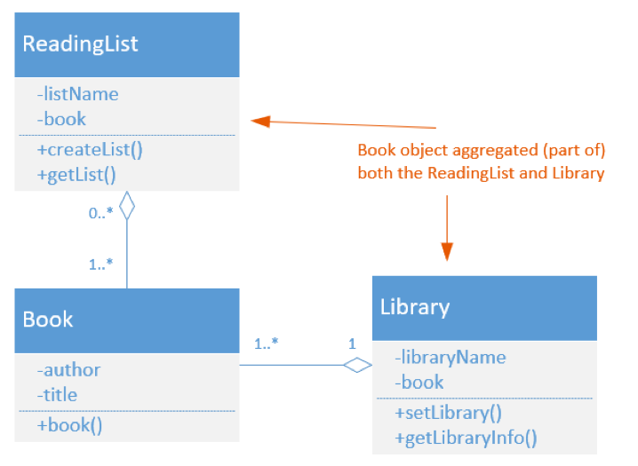
Aggregation
Aggregation indicates the structural inclusion of objects of one class by an object of another class, in other words, one object is part of another object.
In Aggregation relationships the object which is part of another object (or aggregates) can exist on its own.

Slide 41
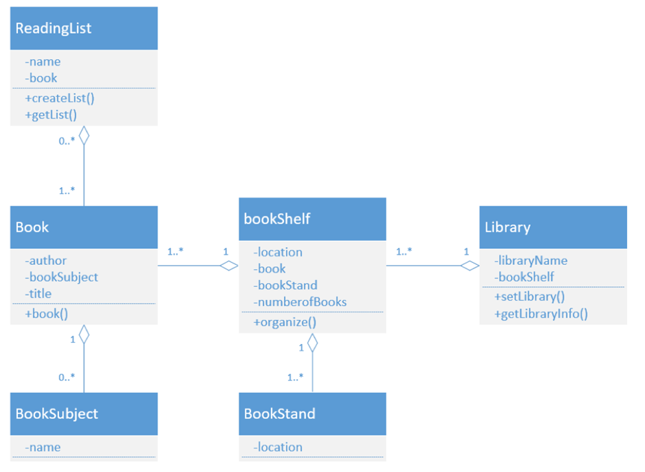
Aggregation

Slide 42
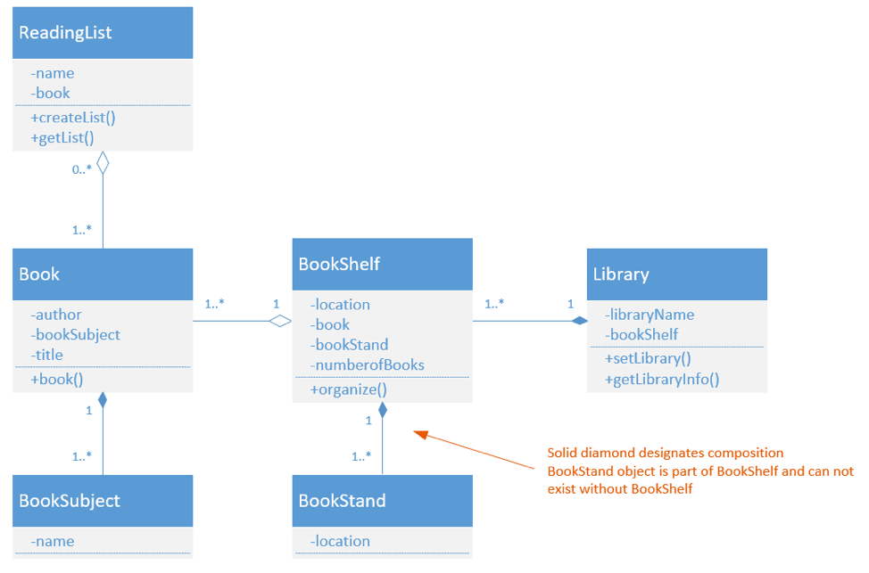
Composition
Composition –is a stronger form of aggregation in which the aggregated object exists only during the lifetime (and for the benefit of) the composing object: No other object may reference it.
If the “whole” were to die, the “part” would die with it.

Slide 43
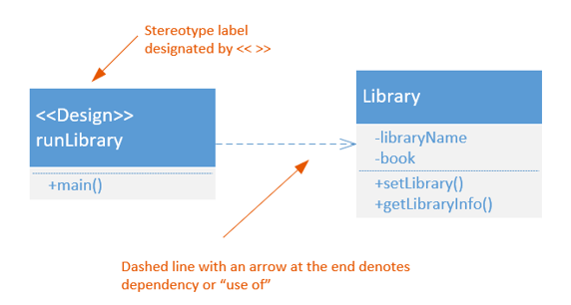
Dependency
Indicates that the Source class Depends (uses) the target class. (Note the “narrow” Arrow Tip style)
Can be used to show relationships between design and entity classes.
The UML User Guide defines stereotypes as a way to label similar classes within a particular domain, in affect creating a metatype (a type that defines other types). (Booch, Rumbaugh, Jacobson, 2014)

Slide 44
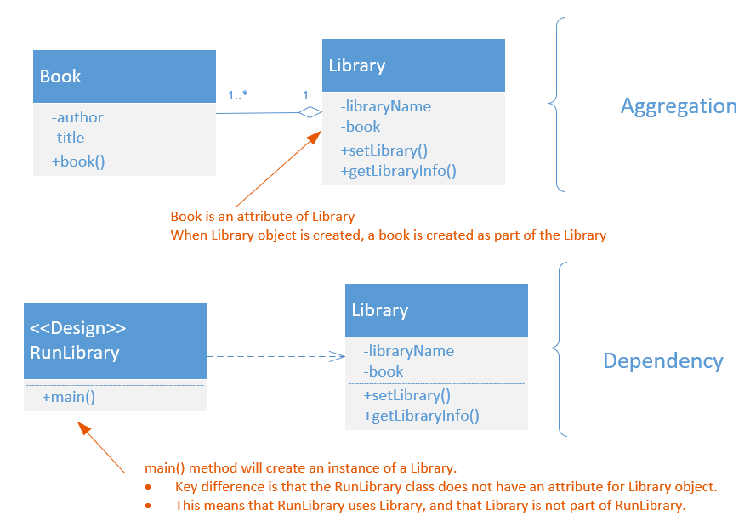
Aggregation or Dependency?

Slide 45
Class Diagram – what to model
Key Note: Not all of the attributes and operations need be specified in the class model.
We show as much detail as needed—no more.
Showing more detail clutters a diagram and can make it harder to understand.
Some required attributes are left to the discretion of the implementers.

Slide 46
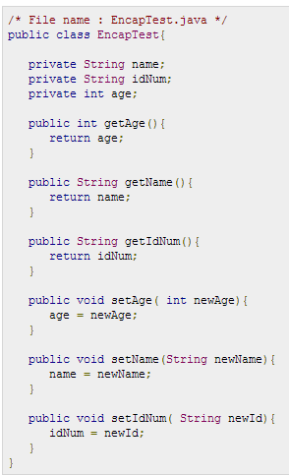
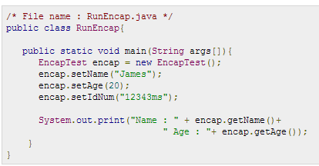

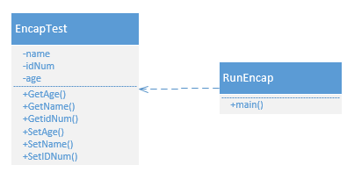
Java example – Class Diagram
http://www.tutorialspoint.com/java/java_encapsulation.htm

Slide 47
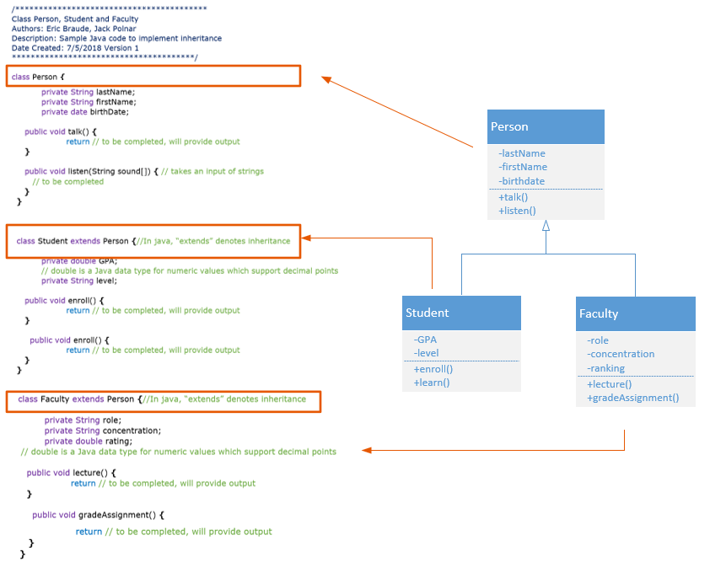

Slide 48
References
Braude, E. Polnar J (2019). Module 4 IT Systems & Introduction to Process. Metropolitan College, Boston University, Boston, MA.
Whitten, B. (2007). Systems analysis & design methods. (7th ed.). New York, NY: McGraw-Hill Irwin.
Booch G, Rumbaugh, J, Jacobson I (1999). The Unified Modeling Language Reference Manual. Upper Saddle River, NJ : Addison-Wesley.
Booch G, Rumbaugh, J, Jacobson I (2014). The Unified Modeling Language User Guide. Upper Saddle River, NJ: Addison-Wesley.
Dennis, A., Wixom, B. H., & Tegarden, D. (2015). Systems Analysis & Design An Object-Oriented Approach with UML (5th ed.). Wiley.

